Slide 1

College Football EDA
Dan Wiltse
05/30/2020

Slide 2
Statistical question
What factors contribute to college football teams winning more than others?

Slide 3
Variables Used
Variable | Description
Wins | Total wins during the 2019 college football season
PF | Points scored by the team during the season
PA | Points scored by opposing team during the season
Five_year_avg_recruit_rank | Average recruiting class rank across previous five recruiting classes (2015-2019)
OffensesuccessRate | efficiency metric that determines the success of a play. Successful plays meet one of the following criteria: the offense scored 1st downs which gain at least 50% of the yards to go 2nd downs which gain at least 70% of the yards to go 3rd and 4th downs which gain at least 100% of the yards to go
DefensesuccessRate | Same criteria for offense success rate above, only for team’s defense
Defensehavoctotal | percentage of plays in with the defense recorded a TFL, forced a fumble, intercepted a pass or broke up a pass

Slide 4
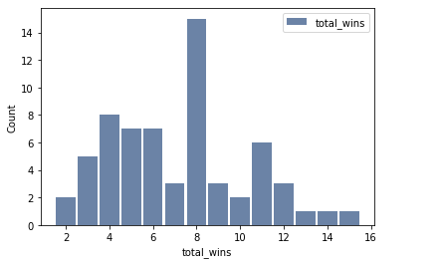
Histogram
Most common win total is 8

Slide 5
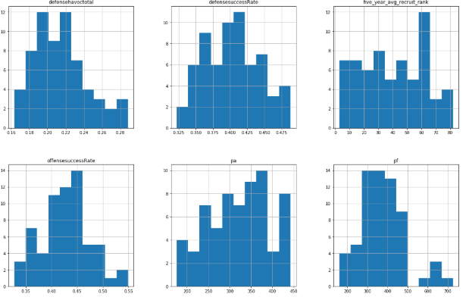
Histograms
- None of the variables had normal distributions due to certain teams having extremely strong offenses or defense (or extremely weak defenses and offenses)
- Kept in variables as they impacted win totals
- Ex – Points For – there were 5 teams that scored more than 500 points, all but one of them made the playoffs

Slide 6
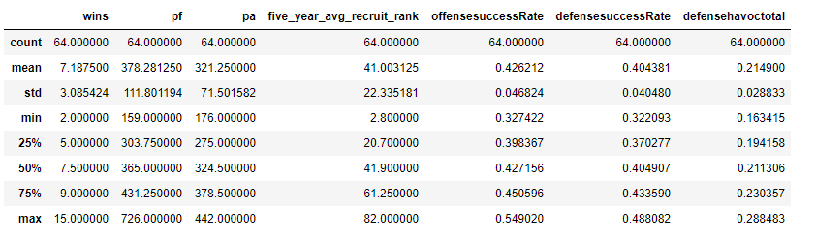
Descriptive Statistics

Slide 7
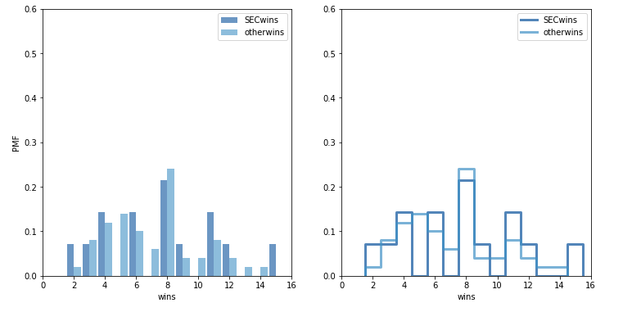
PMF – SEC wins vs all other conferences
- Comparing SEC wins versus all other conferences
- SEC is skewed right compared to other conferences due to two highly successful teams (Alabama and LSU) but both conferences had most teams with 8 wins
- SEC also had slightly higher percent of PMF in lowest portion of PMF as well

Slide 8
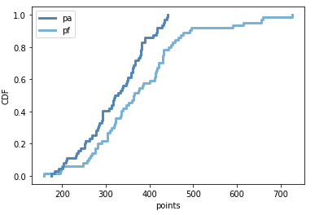
CDF
Comparison of Points For and Points Against
- Longer tail on points for than points given up, showing bigger variability in offensive points

Slide 9
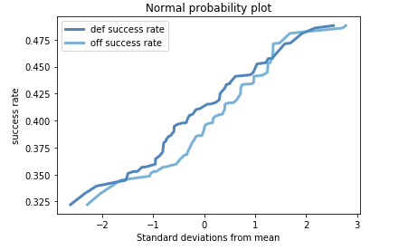
Analytical Distribution
Normal Probability Plot
Similar trending of standard deviations across offensive and defensive success rate

Slide 10
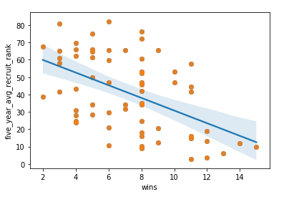
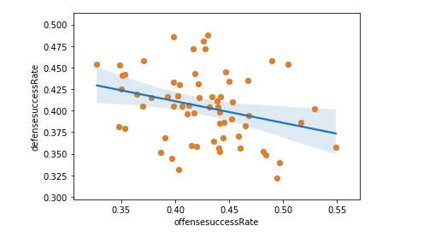
Correlations
Wins by Recruiting Ranking Offense vs Defense Success Rate
Better recruiting ranking related to more wins Appears to be slight relationship between offense and defense
success rate

Slide 11
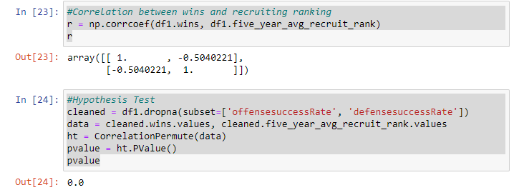
Hypothesis Test
Correlation can be small but still be statistically significant. Correlation between two metrics is -.504, which means the lower your rank (1 is best rank), the more likely to win more games.
Hypothesis test below shows a relationship between the two variables as well, pvalue = 0.0.
Doesn’t mean relationship is significant, just means that it’s unlikely that the effect occurred by chance

Slide 12
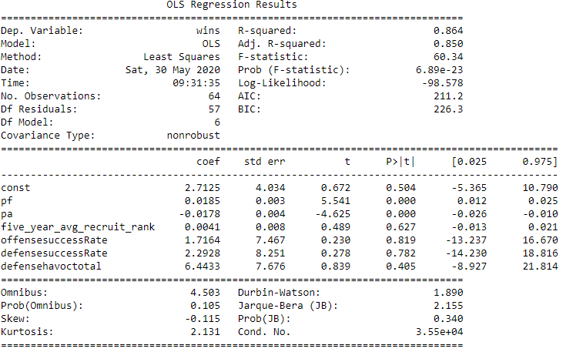
Regression Analysis – All Metrics
Looked at both offensive and defensive metrics combined
Points Against and Points for were significant variables
None of the other variables were significant
Adjusted R Squared - .85

Slide 13
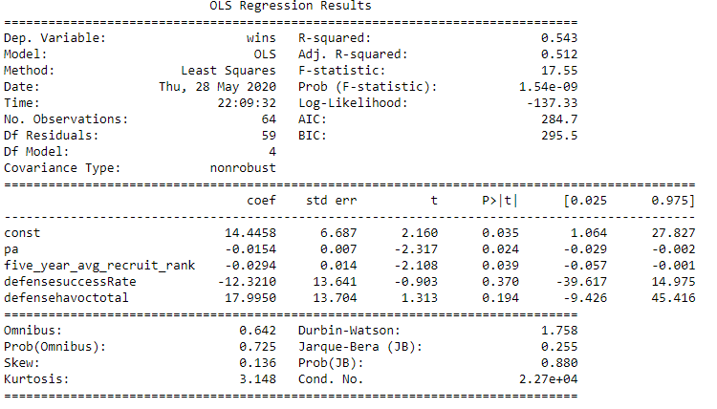
Regression Analysis – Defense Only
Looked at defense only metrics to see if defense wins championships (or predicts wins)
Points Against and Recruiting Ranking were significant variables
Defense Success Rate and Defense Havoc Total were not statistically significant
Adjusted R Squared: .512

Slide 14
Summary
- Several Factors contribute to wins in college football
- As expected, the amount of points scored (or given up) had highest impact on winning
- Recruiting ranking also highly correlated but was only significant in defense-only regression model
- Offense and defense success rate didn’t appear to have a big impact on predicting wins in the regression model
- Further analysis needed to see if there are conference difference impacts in these metrics, versus looking at all teams across all conferences.

